Slide 1

Department of CSIT
COURSE NAME
FOUNDATIONS OF CLOUD-NATIVE COMPUTING & DEVOPS
COURSE CODE –24CS2260F
Topic:
documenting decisions with ADRs
Session - 7

Slide 2
Why Document Decisions?
In real-world systems, many architectural decisions are made under constraints such as time, cost, and risk.
Without documentation, teams forget why decisions were taken, leading to confusion and repeated debates.
Documenting decisions ensures continuity, especially when team members change or systems evolve.

Slide 3
What is an ADR?
An Architecture Decision Record (ADR) is a short text document that captures:
A significant architectural decision
The context in which it was made
The decision itself
The consequences of that decision
ADRs focus on decisions, not on full system design.

Slide 4
Why ADRs are Important in Kubernetes Projects
Kubernetes environments involve many choices such as:
Deployment strategies
Security mechanisms
Observability tools
Cost optimization approaches
ADRs help explain why a particular option was chosen over alternatives, improving system transparency and future decision-making.

Slide 5
Short-Form ADRs – Concept
Short-form ADRs are lightweight and concise.
They avoid long explanations and focus only on essential information.
This makes them easy to write, review, and maintain, especially in fast-moving DevOps and Kubernetes environments

Slide 6
Typical Short-Form ADR Structure
A short-form ADR usually contains:
Title
Context
Decision
Status
Consequences
This structure balances simplicity with clarity.

Slide 7
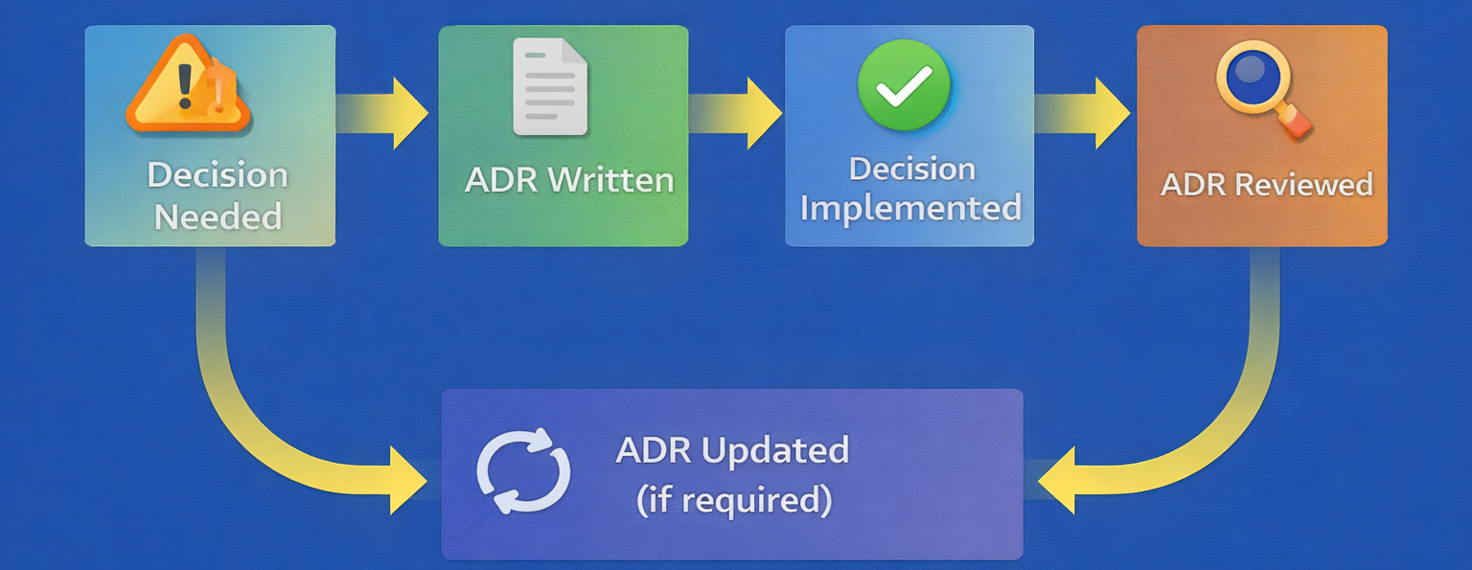
ADR Lifecycle
ADRs are living documents and may be revisited if assumptions change or better solutions emerge.

Slide 8
Example ADR
Context: The Kubernetes cluster hosts multiple microservices. Secret values must be stored securely and shared across environments. Storing secrets in plain YAML files poses a security risk.This section explains the problem and constraints clearly.
Decision: Use Kubernetes Secrets combined with Sealed Secrets to store and manage sensitive configuration data securely.The decision is stated clearly without ambiguity.
Consequences:
Secrets can be safely stored in Git repositories
Additional tooling (kubeseal) is required
Slight increase in operational complexity
Improved security and auditability
Consequences may include both benefits and trade-offs.

Slide 9
Where to Store ADRs
Common locations for ADRs include:
Git repositories alongside source code
/docs/adr/ folders
Project documentation portals
Version control ensures ADRs evolve with the system.

Slide 10
Best Practices for Writing ADRs
Keep ADRs short and focused
Write ADRs when decisions are made, not later
Use clear and simple language
Do not delete ADRs; mark them as superseded
Good ADR hygiene improves long-term maintainability.

Slide 11
Summary
Architecture Decision Records provide a simple and effective way to document important design decisions.
Short-form ADRs are especially suitable for Kubernetes and DevOps environments where rapid change is common.
By recording context, decisions, and consequences, ADRs support clarity, accountability, and production-ready system design.

Slide 12

THANK YOU
Team –Foundations Of Cloud-native Computing & Devops

